Slide 1
The Evolution of Internet Architecture
Geoff Huston AM
Chief Scientist, APNIC
April 2025

Slide 2
The Victorian Internet – the Telegraph
In 1800 Alessandro Volta invented the battery that allowed electricity to be used in a controlled manner
In 1820 Hans Christian Oersted demonstrated the connection between electric current and magnetism
In the 1830’s in the UK William Cooke and Charles Wheatstone used a system of five pointers to send text - the first use was railway signalling in the UK
In the 1840’s Samuel Morse developed a simpler system using a keypad to complete a circuit.
By 1861 telegraph lines spanned the US
By 1870 an undersea cables spanned the Atlantic

Slide 3
The Great Telegraph Boom
The period from the 1850’s to the 1900 saw major investments in national and international telegraph cable systems
Most of the initial international investment activity was from the UK – by 1982 British companies owned and operated two thirds of the world’s telegraph cables.
In the US newspapers expanded 5-fold in the period 1840 – 1860 as 50,000 miles of telegraph cable were installed
When combined with the railway this became an effective means for the projection of power and control – enterprises saw opportunities in extensive reach, creating private monopolies to complement the older state-sponsored monopolies

Slide 4
The Next Wave: the Telephone
First shown to the world at the 1876 World Exposition at Philadelphia, its invention triggered a struggle to the death between Western Union’s telegraph and Bell’s telephone
  Although Western Union never fully appreciated that the telephone was an existential threat to the telegraph until it was simply too late.
Thousands of regional telephone companies appeared all over the world in the following years

Slide 5
The Formation of the Telephone Cartel
Theodore Vail - President of American Telephone and Telegraph (twice!) - oversaw the construction of a national monopoly masquerading as a public utility through the Kingsbury Commitment with US Congress in 1913
AT&T divested itself of Western Union Telegraph and in return created a substantial private monopoly under the catch cry of “one policy, one system and one universal service”
Other countries emulated this transformation from competition to national monopoly in just a few years, using existing telegraph monopoly to subsume telephone operators into public utility structures

Slide 6
The Telephone Network
This was the major technology achievement of the twentieth century. This network:
  Connected handsets to handsets
  Was intentionally transparent
  Was implemented by real time virtual circuit support between connected edge devices
  And was designed as a network-centric architecture with minimal functionality in the edge devices

Slide 7
The rise of Computer Networks
The original concept for computer networks was based entirely on the telephone network
The network was there to enable connected computers to exchange data within a context of dynamic point-to-point two-party connections:
  All connected computers were able to initiate or receive “calls”
  A connected computer could not call ”the network” – the network was an invisible common substrate
  It made no difference if the network had active or passive internal elements

Slide 8
Internet Architecture (c1980’s)
“End-to-End” Datagram Packet design:
  Connected computer to computer
  All data is segmented into independent packets
  The network switching function was stateless
    No virtual circuits, no dynamic state for packets to follow
  All endpoints are uniquely addressed
  Single network-wide addressing model
  Single network-wide routing model
  Simple datagram unreliable datagram delivery in each packet switching element
  hop-by-hop destination-address-based packet forwarding paradigm

Slide 9
Internet Architecture (c1980’s)
IP Network
TCP/IP Engine
TCP/IP Engine
TCP hosts

Slide 10
The Result was Revolutionary!
  By stripping out network-centric virtual circuit states and removing time synchronicity the resultant packet carriage network was minimal in design and cost and maximized flexibility and efficiency
  More complex functions, such as flow control, jitter stability, loss mitigation and reliability, were pushed out to the attached devices on the edge

Slide 11
But
The price of runaway success is uncontrolled growth!
  The underlying connectivity fabric and IP routing systems were under scaling pressure
  We needed a way to respond to continual growth in a way that allowed aggregation of individual requirements
  The response was aggregation in addressing, routing and connectivity

Slide 12
Scaling Routing and Connectivity by Role Specialization
In the regulated world of national telephone operators every telephone network was “equal”
Markets do not normally support such outcomes, and we saw role specialization as a way of sustaining efficient distribution chains to support public services
We rapidly started differentiating between Internet networks differentiating on roles and services to allow effective aggregation and differentiating on the flow of revenues between networks

Slide 13
The 1990’s Internet

Slide 14
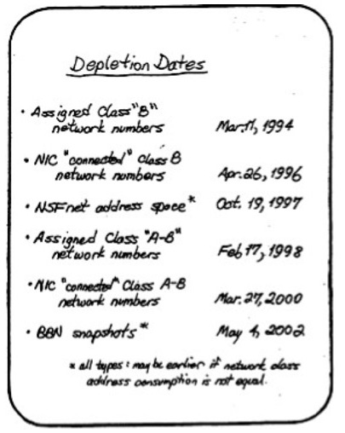
But
That wasn’t the only scaling pressure point
  By 1990 it was clear that the Internet address plan was failing to match the demands of growth of connected hosts
  Our response was IPv6 – an expansion of the address field in IP – which changed little else
Frank Solensky – IETF August 1990

Slide 15
Some changes are easy…
But some are hard!
It was relatively easy to change the underlying connection framework and the routing system
  The scale of the change was a few thousand entities, and the changes were able to be performed in a piecemeal fashion
It was extremely hard to the change the IP protocol in connected devices
  The scale was far greater, the protocol platform was immature and the economic incentives to change did not exist

Slide 16
The cost of peer-to-peer
Uniquely addressing each connected device has been very resistant to scaling pressures
The pragmatic response has been to dispense with unique addresses for most connected devices, and instead of further refining a peer-to-peer network we’ve turned our attention to moving into client/server networks

Slide 17
Client/Server
Breaking the edge into clients and servers
  Access networks service the needs of “clients”
  Clients are not directly reachable by other clients
  Clients only connect to services
  Clients don’t need persistent external addresses
Services need persistence in terms of identity to facilitate client connection, while clients don’t

Slide 18
Addressing for Clients
Clients do not need a persistent external address as they are never the target of service binding operation
  Clients can “borrow” a session token from a common location-based address/port pool – NAT
NATs are incrementally deployable
Provide a network-level response to address scaling issues
And are the mainstay of today’s IP-level Internet

Slide 19
Addressing for Servers
Servers require a persistent service identity
But that’s not quite the same as a need for a persistent IP address
The model of service provision has evolved over time…

Slide 20
The Evolution of Service Models
Content Server

Slide 21
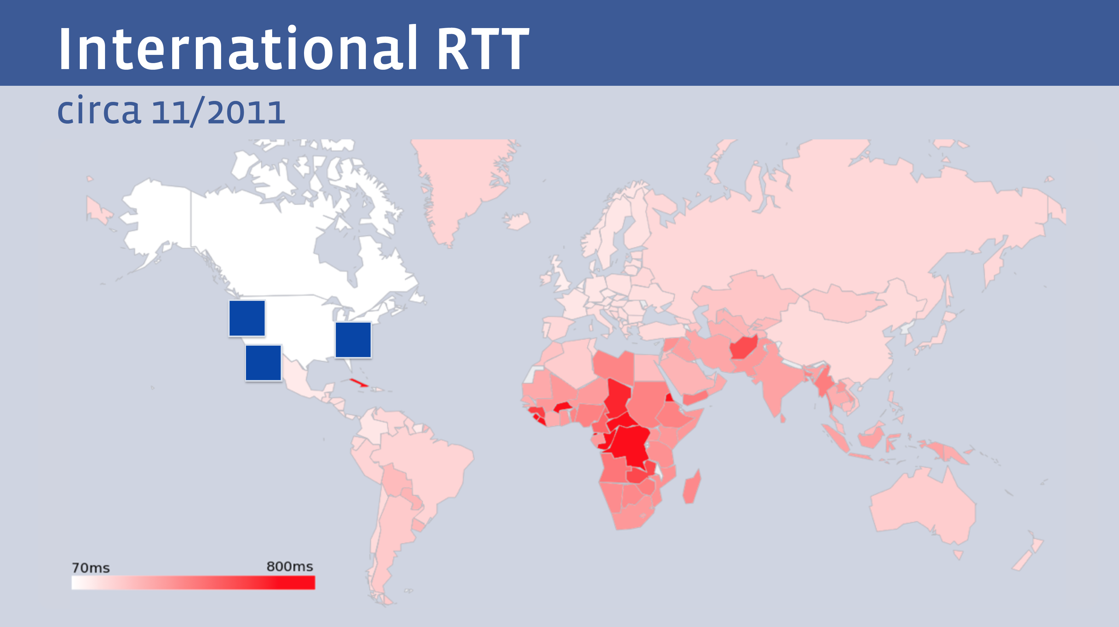
The Tyranny of Distance
  But not all clients enjoy the same experience from a single service
Facebook presentation at NANOG 68 - 2011

Slide 22
Content Distribution Networks
Content Distribution Network

Slide 23
Let them eat data!
The rise of the Content Distribution Network
  Replicate content caches close to large user populations
  The challenge of delivering many replicant service requests over high delay network paths is replaced by the task of updating a set of local caches by the content distribution system and then serving user service requests over the access network
  Reduced service latency, increased service resilience, happy customers!

Slide 24
How to Replicate Service?
IP Anycast
  Use the DNS to map the service name to an IP address
  Originate a route to this service address in BGP from many locations
  Use the BGP’s preference for “shortest path” to offer the closet instance of each service platform to each user

Slide 25
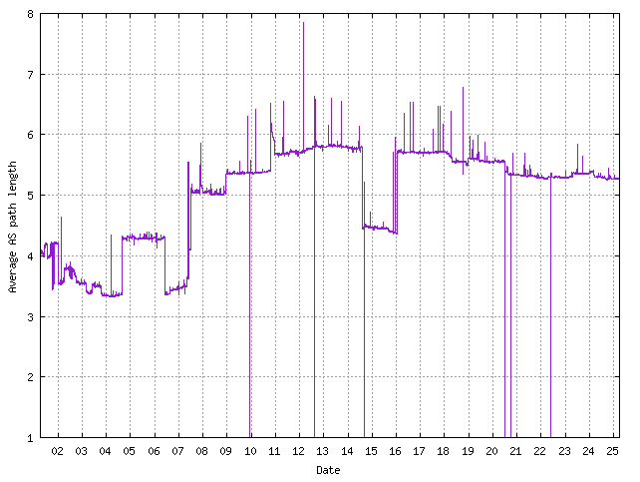
How to Replicate Service?
IP Anycast has some issues :
BGP routes on minimizing AS Path length, not delay, load or responsiveness
the BGP network is dense (heavily compressed) and the average AS Path length is too small
Route instability throws off long-held sessions
This implies that Anycast service platforms are prone to poor service selection and low stability stability
Which means that anycast works best for short, simple service transactions (e.g. DNS) and not for longer sustained transactions (e.g. video streaming)
25 years of BGP Average AS Path Length – AS131072

Slide 26
How to Replicate Service?
DNS Service Steering
  Replicate the service on a number of platforms, each with their own IP address that is location-based.
  Alter DNS authoritative servers to perform distance calculation between the DNS querier and the collection of available service platforms, and respond with the IP address of the “closest” service platform
Client is located in Sydney, Australia
$ dig www.sbs.com.au
;; ANSWER SECTION:
www.sbs.com.au. 179 IN CNAME www.sbs.com.au.edgekey.net.
www.sbs.com.au.edgekey.net. 179 IN CNAME e7065.b.akamaiedge.net.
e7065.b.akamaiedge.net. 3 IN A 104.116.108.252
Server is located in Sydney, Australia

Slide 27
How to Replicate Service?
DNS Service Steering
  Replicate the service on a number of platforms, each with their own IP address that is location-based.
  Alter DNS authoritative servers to perform distance calculation between the DNS querier and the collection of available service platforms, and respond with the IP address of the “closest” service platform
Client is located in Frankfurt, Germany
$ dig www.sbs.com.au
;; ANSWER SECTION:
www.sbs.com.au. 250 IN CNAME www.sbs.com.au.edgekey.net.
www.sbs.com.au.edgekey.net. 235 IN CNAME e7065.b.akamaiedge.net.
e7065.b.akamaiedge.net. 20 IN A 23.35.228.216
Server is located in Frankfurt, Germany

Slide 28
How to Replicate Service?
DNS Steering has some issues:
  This approach assumes that the DNS recursive resolver is located close to the end client - which breaks down with the use of remote DNS recursive resolvers (Google, Cloudflare, Quad 9)
    The inclusion of the Client’s subnet into the DNS Query is somewhat of a privacy leak
  Dynamic changes to the service constellation is hard to control due to DNS content caching.
  Load Balancing across multiple service platforms can be challenging

Slide 29
How to Replicate Service?
Application Steering
  Break the content into separate service “chunks”
  Replicate the service chunks on a number of platforms, each with their own IP address that is location-based.
  Have the application direct the client to the “closest” chunk server
  Reassign the client to a different server location if application performance falls below some threshold

Slide 30
Service Models
IP anycast is highly effective for short transactions (e.g., DNS over UDP)
DNS steering is effective for high-speed service transactions
Application steering is effective for extended transactions using decomposable elements (e.g., video streaming)

Slide 31
Changes to the Internet
These changes are a reversal of the Internet’s original service delivery model
Instead of using a network to connect local users to remote services in a “just in time” delivery model we now are able pre-provision services to multiple locations that are local to users in a “just in case” service provisioning model
When local users access locally provided services there is no reliance on the network to span a distance gap
No distance implies that we can deliver services that are faster and cheaper

Slide 32
Change
Greater capacity in edge networks has enabled…
Greater use of high-volume streaming content, which has lead to …
Adoption of higher capacity technologies in edge networks, which
Generates economies of scale that enables …
Reductions in the unit cost of carriage in edge networks
“Bigger” induces “Faster” and “Cheaper”!

Slide 33
How did this happen?
The Internet is constructed on the foundation of a market-based economy, not a command-and-control economy
It was assumed that an open market-based activity would generate efficient outcomes based on competitive pressures between providers
Yet the Internet is not a highly competitive environment!
  (indeed, it’s strongly consolidated and not very competitive at all!)
What’s driving this evolution in the Internet’s basic architecture?

Slide 34
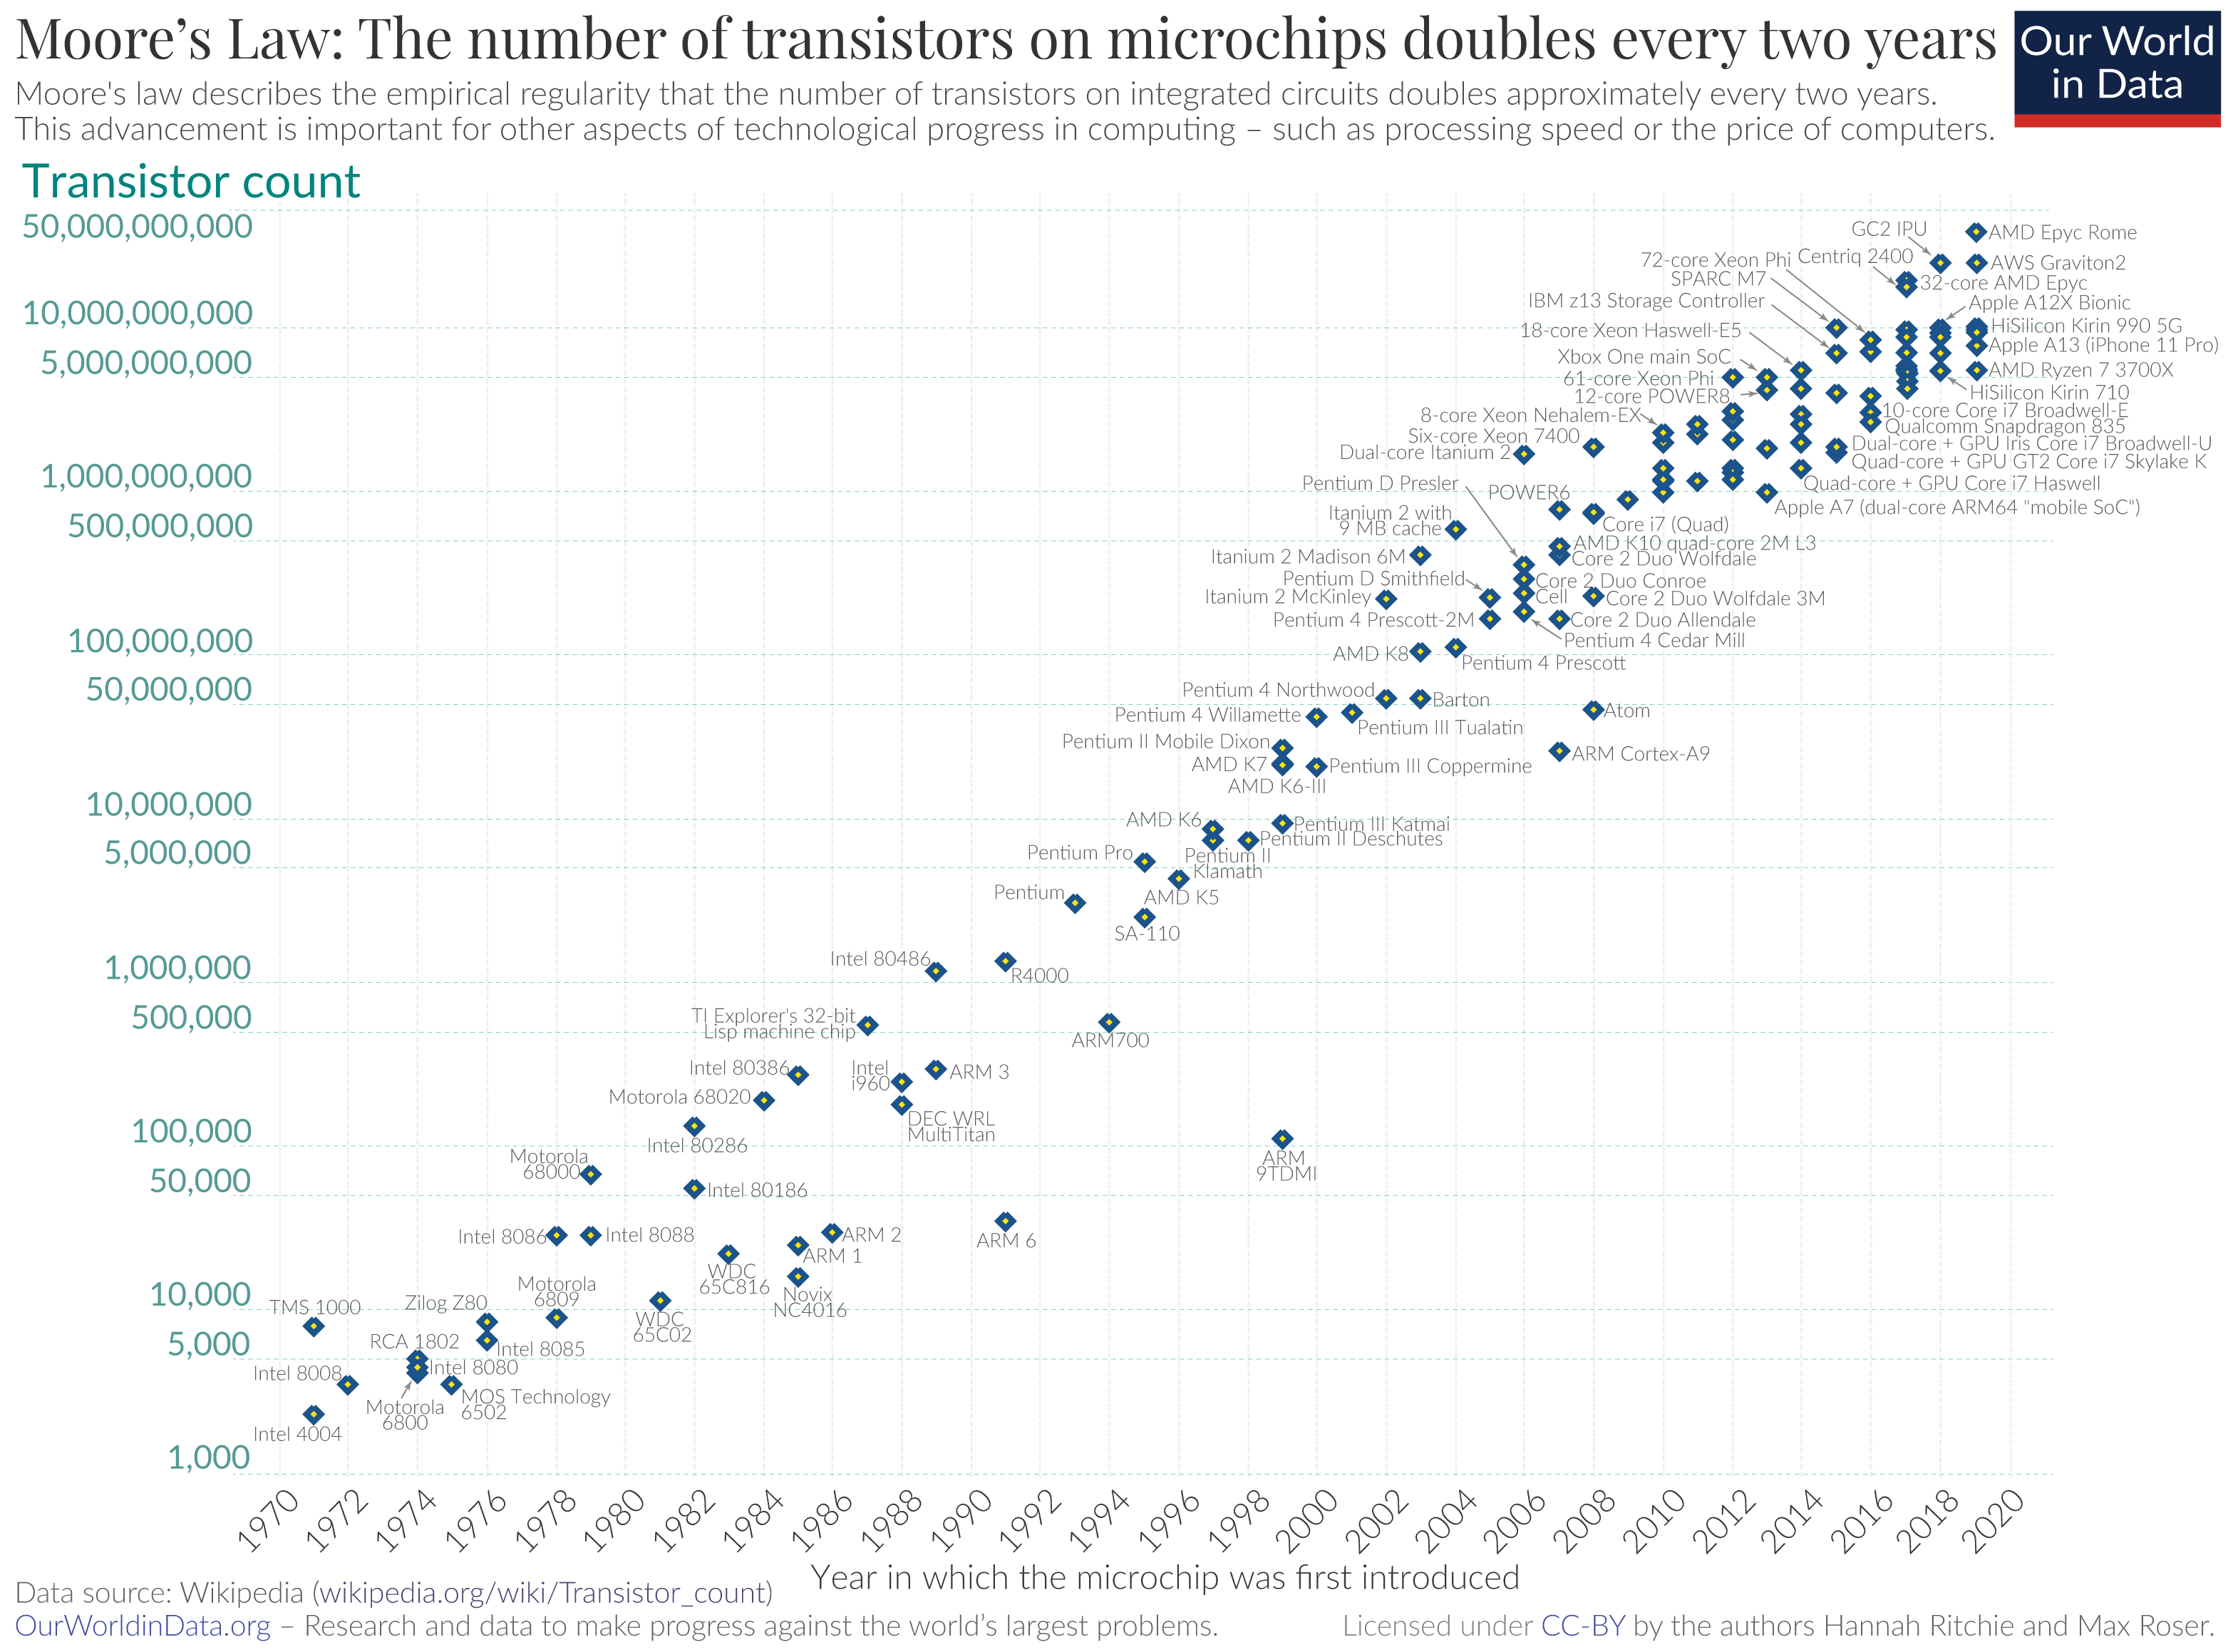
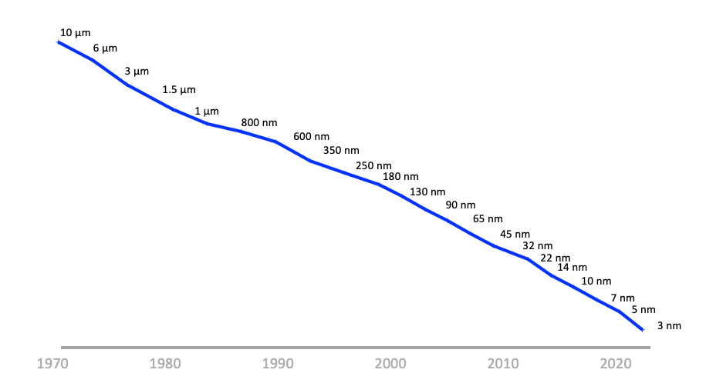
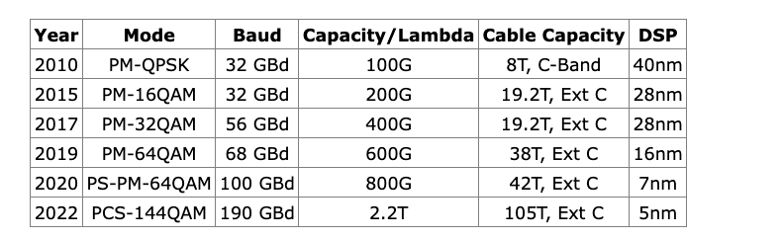
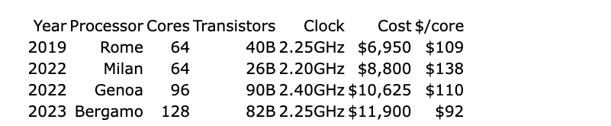
The Driver of Change: Moore’s Law
Silicon Chip Track Width over time
Silicon Chip transistor counts

Slide 35
What does this mean?
The economics of silicon chip evolution have a profound impact on the computing space - few technologies has been able to survive more than 5 years in this sector!
  What was too expensive, too slow, or just impossible to scale up becomes quickly viable when the currency of computation and storage changes so quickly
The result is that no business plan has been able to survive more than 5 years in the computing/communications marketplace!
From planning, to debut, to consolidation, maturity, and then to obsolescence, a market service offering has at best just 5 years to do it all!

Slide 36
Moore’s Law is BRUTAL!
What is driving the economics of digital delivery systems in today’s networks is not the historical use of pricing as a means of rationing access to a scarce common resource
This is an environment that has switched over to abundance of processing, storage and communications
Consolidation and Centrality of goods and service provision is not a surprising outcome in this space – its INEVITABLE
  What would be far more surprising would be if consolidation and centrality was NOT the outcome!

Slide 37

Moore’s Law is BRUTAL!
This is a tough environment where:
  Smaller entities almost always fail
  Some larger entities may get sucked up by being acquired by yet larger entities
  And only the very largest of entities can afford to buy a future
Gittes: How much are you worth?
Cross: I've no idea. How much do you want?
Gittes: I just want to know what you're worth. Over
ten million?
Cross: Oh my, yes!
Gittes: Why are you doing it? How much better can you
eat? What can you buy that you can't already
afford?
Cross: The future, Mr. Gittes - the future!
Chinatown (1974)

Slide 38
Change
Abundance and scale have driven radical changes across the Internet’s basic architecture
  Networks are no longer share common transit services that connect users to services
    (“sharing” is so yesterday!)
  Content distributors are using abundance of computing, storage and communications capacity to bring content and service replicants to each user in advance of actual use (pre-provisioning just in case)
We pre-provision content and service at the edge of access networks and no longer rely on networks to carry user’s traffic to remote service points.

Slide 39
What about network architecture?
We’ve moved beyond address-based network architectures
  Address uniqueness is a “relative” concept, not a “universal” requirement
  Routing has largely been replaced by DNS service selection
Service names are the basic distinguisher in the network
  We use service names to establish a secured transaction context (TLS)
  We use service names to provide authenticity of the service (Domain Name Certification)
  We use the DNS to map a service description to a network rendezvous profile

Slide 40
Is this what “Named Data Networking” was all about?
Yes and No
The basic packet forwarding mechanisms are unchanged from IP – its just that the endpoint addresses used in a session have no enduring permanence beyond that session
Services are named, but that’s not quite the same as naming data
What we have today in the Internet’s architecture* is neither structured nor designed – its more of a hybrid situation that blends a named service environment with IP transport
* it’s probably not even an “architecture” in anything but the loosest sense of that word!

Slide 41
Where is this heading?
We are where we are as a result of the inexorable pressures of Moore’s Law on the technology underpinnings of the Internet, combined with the more chaotic forces of market pressures and macro-economics
This coupled with the scaling pressures bought about by the displacement of more traditional service delivery models by their digital analogues through ubiquitous low-cost digital capability
But it be foolish to think that Moore’s Law will continue to deliver improvements indefinitely – it can’t and it won’t
But what happens then is entirely unclear!

Slide 42
Thanks!

